Slide 1
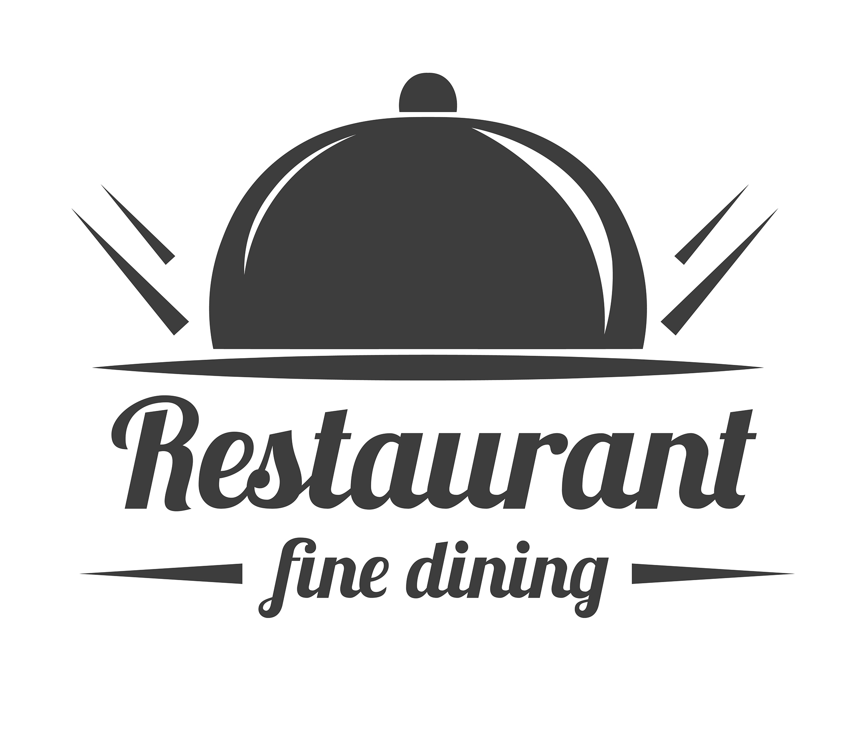
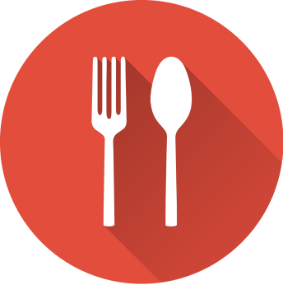
Zomato Analysis
RAHUL MUTALIK

Slide 2

Introduction
Zomato is poised to enter the restaurants business in Bangalore, so this project aims to harness data-driven insights to identify profitable locations, scrutinize competition ,and craft growth strategy.
As data analyst our analysis should provide Zomato with a nuanced understanding of the dynamic Bangalore market, enabling them to make informed decisions that maximize profit and establish a successful restaurant presence.

Slide 3

Objective
Top restaurants in Bangalore.
Most liked type of restaurants
Locations and count of restaurants where most liked restaurants type are present.
Most favourite type of cuisines.
Average cost of 2 people who are willing to dine in a restaurants.
Facilities provided by the restaurants and its effect of ratings.

Slide 4
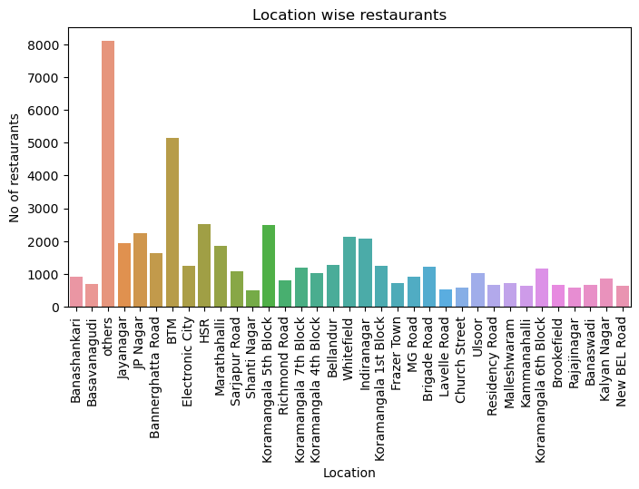
Location wise Restaurants count
BTM and HSR has the highest amount of restaurants .

Slide 5
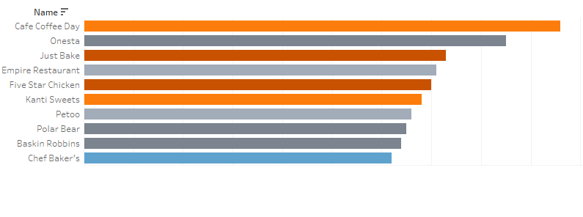
Top Restaurants in Bangalore
Above are the most voted Restaurants in Bangalore.

Slide 6
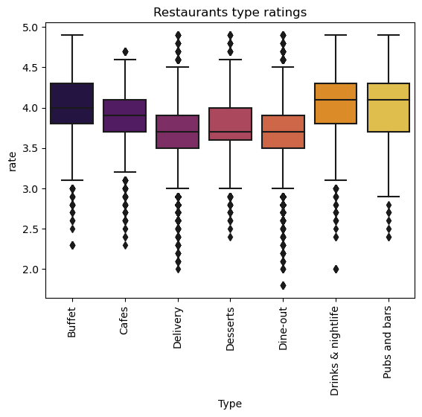
Which type of restaurants are mostly preferred
we can see that most people like or have rated for Drinks& nightlife and pubs and bars

Slide 7
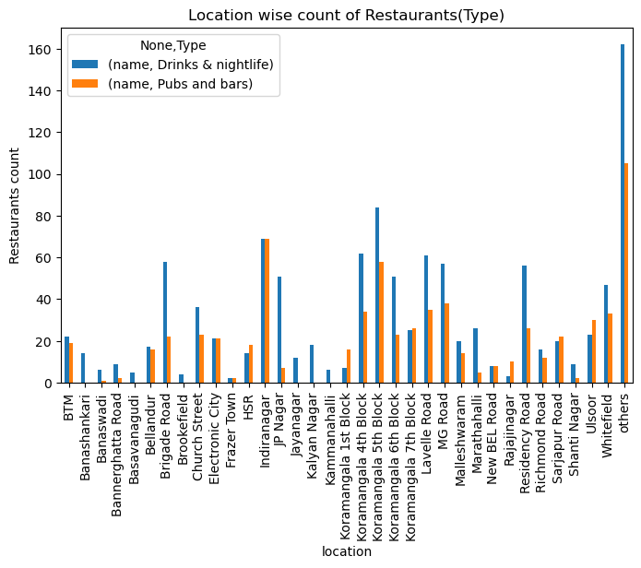
Location wise(pubs & bars )and( drinks & nightlife)type of restaurants
If we want to open pubs& bars restaurants rather opt for Banashankari or jp nagar for pubs and bars and for Drinks and night life opt rajajinagar or brookefield.

Slide 8
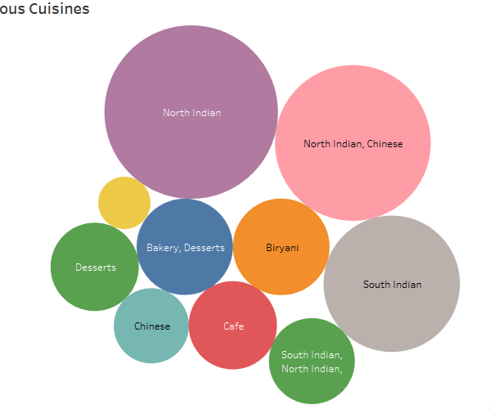
Most favourite Cuisines
North Indian, south Indian , North Indian& Chinese are most liked cuisines.

Slide 9
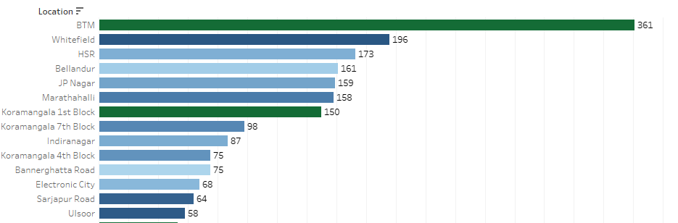
Location and North Indian cuisines

Slide 10
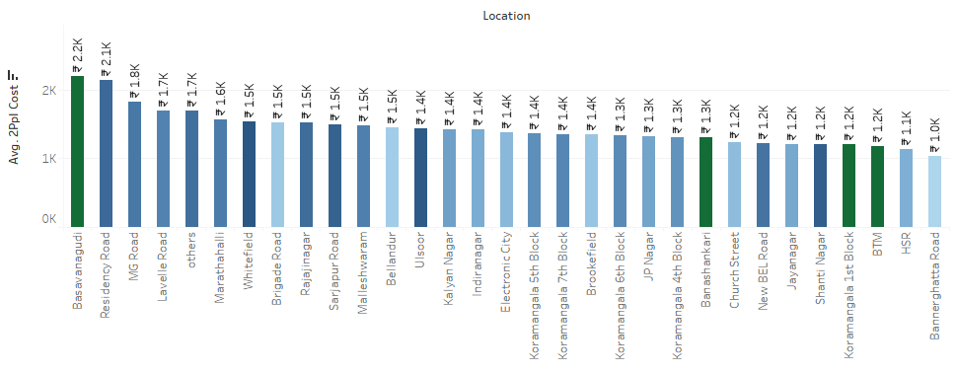
Restaurants and Average Cost of two people based on booking facilities provided
Residency road highest average cost of two people and Brookfield Provide lowest average cost .

Slide 11
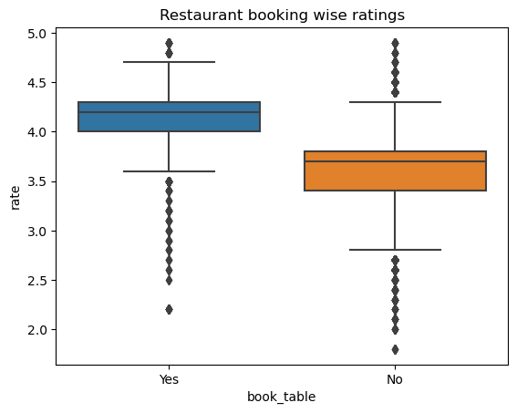
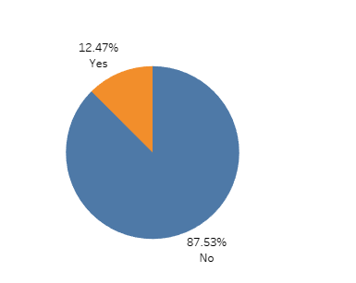
Does Booking facilities Effect the rating for Restaurants
The Restaurants which provide booking table facilities have high rating and only 12.47 percent provide that facility

Slide 12
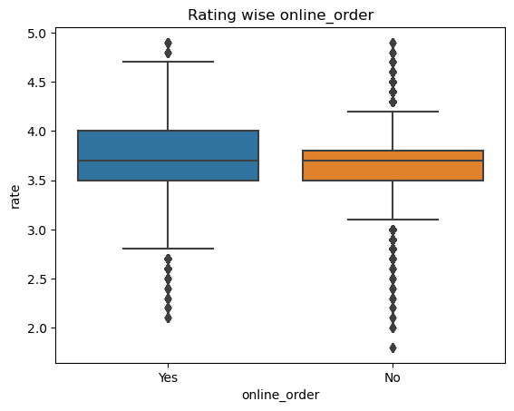
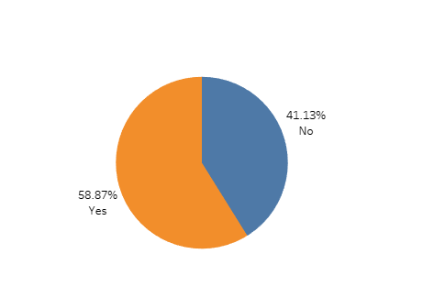
Does Restaurants provide Online order facilities rated good?
Restaurants with online facilities have good rating where over 50 % provide that facilities.

Slide 13
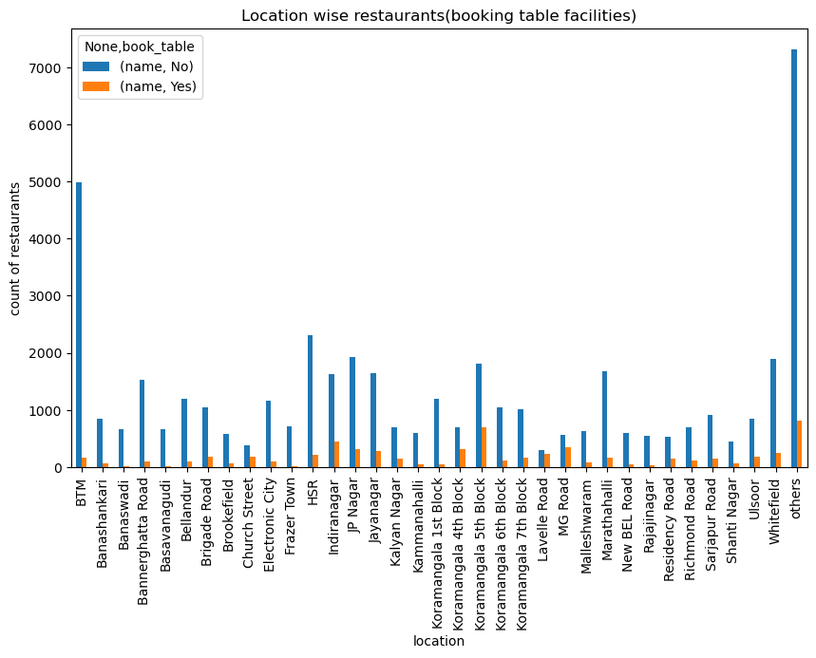
Location wise Restaurants which provide Booking facilities
BTM has least no of restaurants which provide booking facilities, but BTM has lots of restaurants so HSR, Bannerghatta Road have less Restaurants and provide less booking facilities

Slide 14
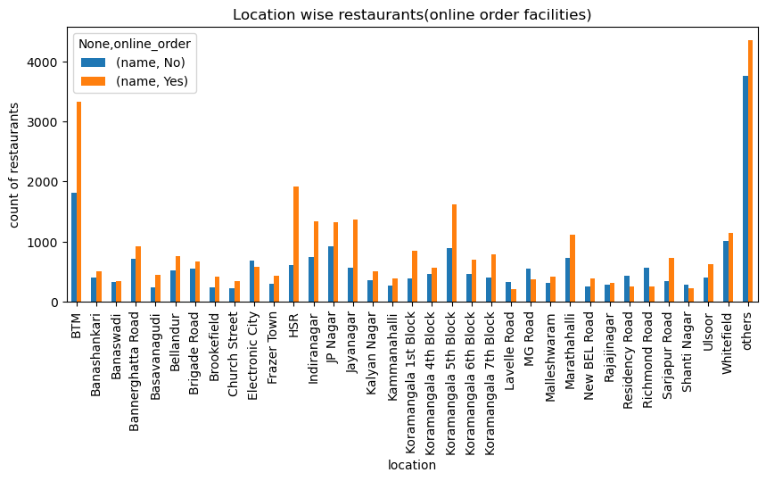
Location wise Restaurants which provide online ordering facilities
Electronic city and Mg road Have good amount of hotels but they don’t provide Online order facilities .

Slide 15
Insights
BTM and HSR has the highest amount of restaurants.
Residency road highest average cost of two people and Brookfield Provide lowest average cost .
North Indian, south Indian , North Indian& Chinese are most liked cuisines.
We can see that most people like or have rated for Drinks& nightlife and pubs and bars.
Electronic city and Mg road Have good amount of hotels but they don’t provide Online order facilities .
The Restaurants which provide booking table facilities have high rating and only 12.47 percent provide that facility
Restaurants with online facilities have good rating where over 50 % provide that facilities.

Slide 16
Recommendations
If we want to open a restaurant don't opt for BTM as it already has most no of restaurants either opt for shanti nagar, church street, Lavelle road.
Its better to provide both Facilities online order , table booking because people tend to like those facilities.
If opening a new restaurants go for types like pubs& bars , Drinks and nightlife then you are mostly like to be making profits.
If opening a new restaurants have these famous cuisines like North Indian, South Indian,Cafe,Desserts which will help in the growth of the restaurants.
If someone wants to open a restaurants based on the pubs& bars, Drinks and nightlife either opt for JP nagar , banashankari for (pubs and bars ) and brookefield, Frazer town for ( drink& nightlife).

Slide 17
THANK YOU

